Slide 1
Lab Safety Reference
Zachary Ahmad (zahmad@caltech.edu)
601-588-5549
June 2024
(DO NOT MODIFY THIS FILE WITHOUT PERMISSION)

Slide 2
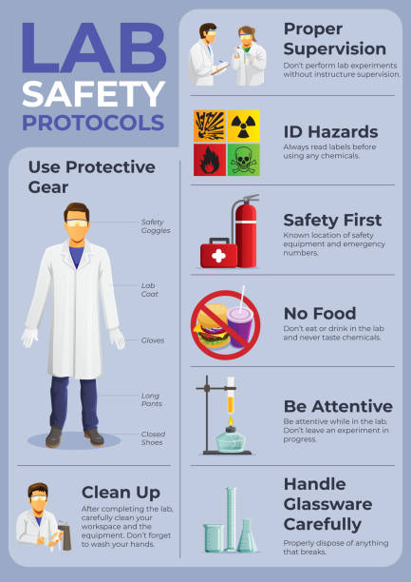
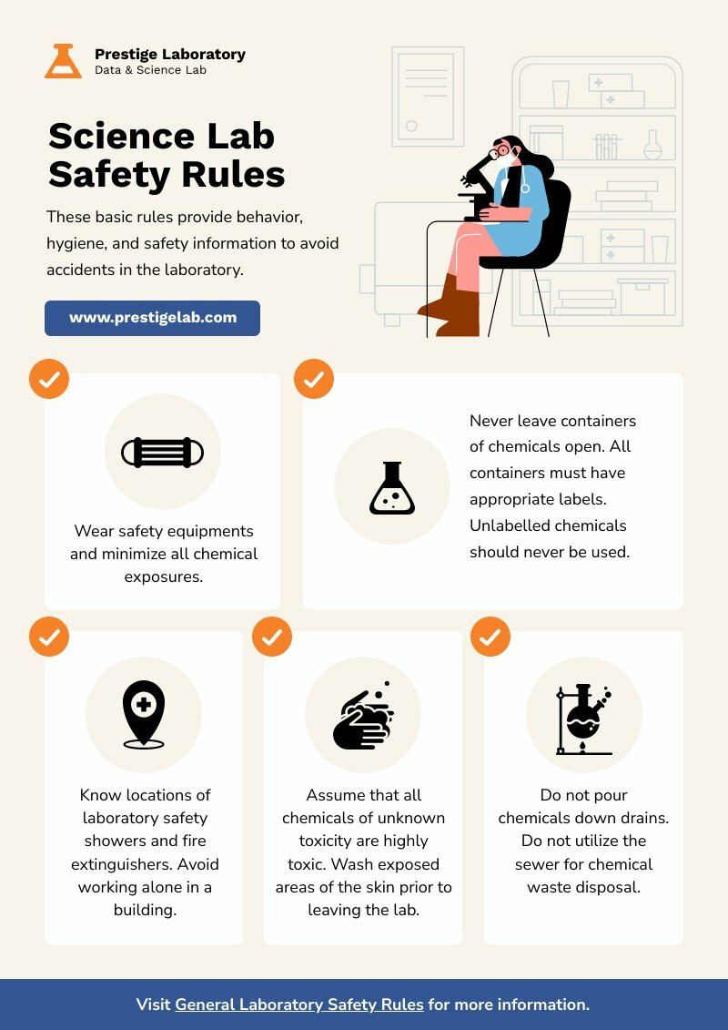

Slide 3

Hazard Label

Slide 4
Chemical storage on shelf/cabinets
Does the chemical have any of these signs/labels?
This needs a secondary container
yes
No
yes
check MSDS online and see if there are any hazards described as the same as above labels?
No
yes
No
Just put in designated area (shelf/etc) without secondary container.
Flammable cabinets
No
yes
or
yes
No
Contact me ASAP. We need to isolate and label time of receipt.
Also separate Disposal of waste!
Oxidizer/Corrosive shelf/4c/Liquid cabinet
Toxic/poisonous/hazard containers

Slide 5
Other notes
Always check if the chemical is air sensitive (need to flush N2 and seal with parafilm), ask Zac how to deal with it.
Check if it's water sensitive, ask Zac how to deal with it.
Check if it needs refrigeration/freezing and do so asap. Do not leave it in Room temperature for more than necessary
If you receive a chemical, please give Zac the packing slip.

Slide 6
Waste Disposal
Note:
Glass/Sharps Disposal Next Slide
Only non-toxic liquids/water?
YES
NO
Dump liquids down sink, throw in trash
Anything Flammable?
YES
no
Pour the liquid into flammable waste bottle in flamm. Hood then dump the container into flammable solid red bucket.
Anything Corrosive/Oxidizer?
yes
no
Pour the liquid into acid OR base corrosive waste bottle in hood then dump the container into corrosive/oxidizer solid red bucket.
yes
no
Pour the liquid into flammable or corrosive waste bottle in hood then dump the container into corrosive/flammable solid red bucket.
yes
Does it clog the drainage pipe (like sticky polymers)?
no
Note:
If you handle peroxide forming chemicals, its wastes need to be in a solo waste bottle (contact me asap).
Always ask if you have any questions!!!
Directly dump liquid in sink and container into trash

Slide 7
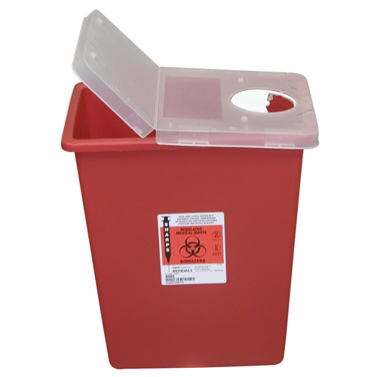

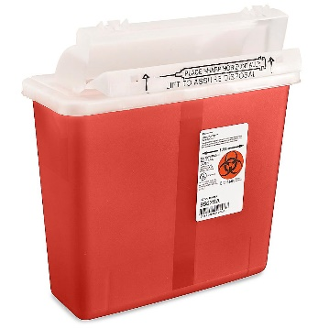
Glass/Sharps disposal
Note:
If extremely volatile chemical, you can either:
Dispose of in small sharps container in fume hood in 336A
Rinse several times and dispose of in large sharps container outside of fume hood
Dispose of in small sharps container in fume hood
Razor blades, needles?
NO
YES
NO
Glass (slides, vials, equipment)
Non-Toxic?
Dispose of in large sharps container outside of fume hood
Non-Toxic?
YES
YES
NO
Broken Glass?
Small (<2 ml vial) and volatile?
NO
Pour liquids into appropriate liquid waste, rinse once and dump in appropriate liquid waste, dispose of glass in large sharps container
YES
NO
YES
Clean broken glass up with a paper towel so as to not cut yourself, dispose of broken glass in cardboard glass container
Dump liquids down sink, throw in trash
Pour liquids into appropriate liquid waste, dispose of glass in small sharps container in fume hood

Slide 8
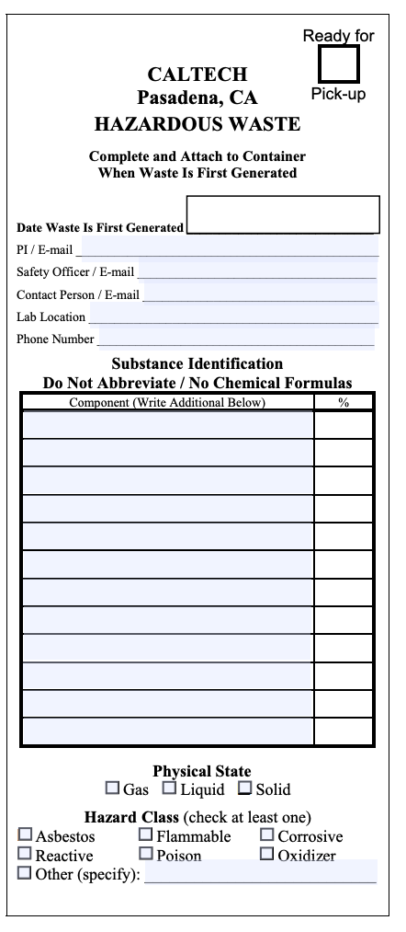
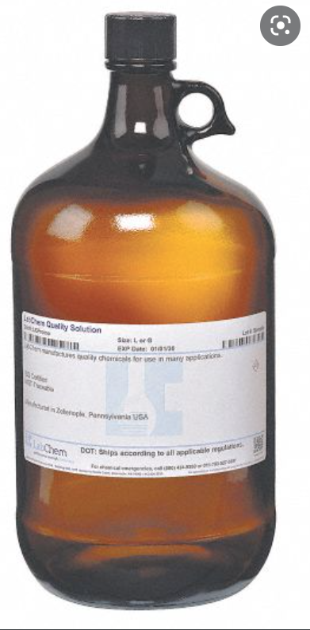
Waste Accumulation
Generally, just contact me and I’ll do this for you
Never overfill the waste bottle or waste bucket!!!! Let me know when you see it almost full!!!
Always write FULL NAME of the chemical onto the waste tag you add in the container. CHECK if it's the appropriate container before you dump it!!!
CHECK if it's full before you dump. If it's full start a new container and attach a new waste tag.
Please transfer full waste bottles to the red secondary container by the door to 210 and notify the safety officer
Aim at the container. DO NOT toss it outside the waste bag or spill it.
DO NOT DUMP SOLID TIPS/THINGS into the LIQUID WASTE BOTTLE!!!!
THIS IS FULL!!!! DO NOT ADD
Fill these
Let me know as soon as you pour your waste in but DO NOT pour over the RED LINE.
waste tag

Slide 9
PPE & Labeling
LONGPANTS & close toed shoes always needed. Tie your hair if you have long hair.
Always wear gloves when working in lab touching any pipets/tips. Preferably sanitize all surface (mouse/benchtop) with 70%ethanol.
Wear Lab coats and goggles and mask if you deal with any hazardous chemicals (flam/corr/oxidizer/toxic/poisonous/carcinogen/Peroxide forming). ASK Zac if you need to deal with any infectious/harmful biohazard. DOUBLE Layers of GLOVES if you need to pour corrosives.
Handle CORROSIVE/OXI. Liquid ONLY in Corrosive hood; handle flammable liquid only in flam hood. NEVER MIX!!!
IF you have to handle/pour stock solution of corrosives/oxidizer/flammable (taking the bottle >500mL), you need to do it when there's another LAB Mate physically present in the lab so that someone can call emergency if something happens. (Buddy system)
LABEL if you are heating something in the hood (what's in the container, how long you do it, your name)
Label your initials on the container, what's inside the container when you have temporary solutions/items.
DO NOT leave personal samples loosely placed in the fridge/freezer. Place it in a holder/ziploc/petri dish and label it with your initials/name. Remove your personal samples once you don’t need it anymore from the fridge/freezer and dispose accordingly. If you have some spared/unused sweat samples, ask in Slack and people can pool the sweat for further tests.

Slide 10
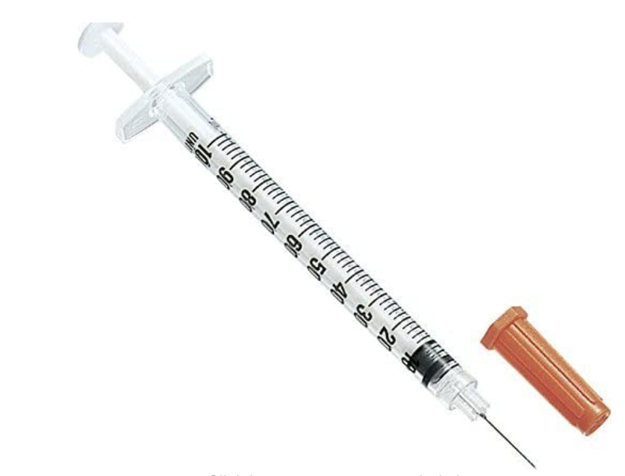
Other notes
-ALWAYS clean up after using the balance. Sweep off and wipe off the residues.
-Always fill the water to "operation level" when using the sonicator. If you need to heat up, empty the hot water after your use.
-Always TURN OFF the pump after you finish vacuum!
-Always turn off the light source for the microscopes and cover it after your use.
-DO NOT LEAVE BLADES OPEN in the air.
-Always ASK if you are unsure of anything/procedure!
ENTIRE syringe goes in sharps box! Custodians cannot always tell if a needle is attached or not!

Slide 11
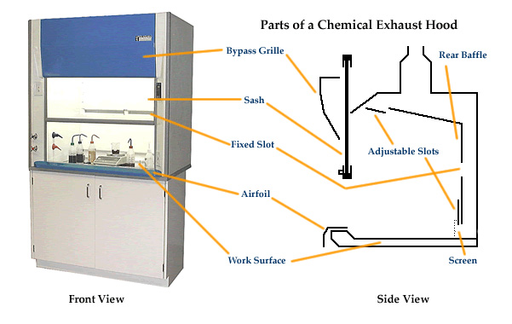
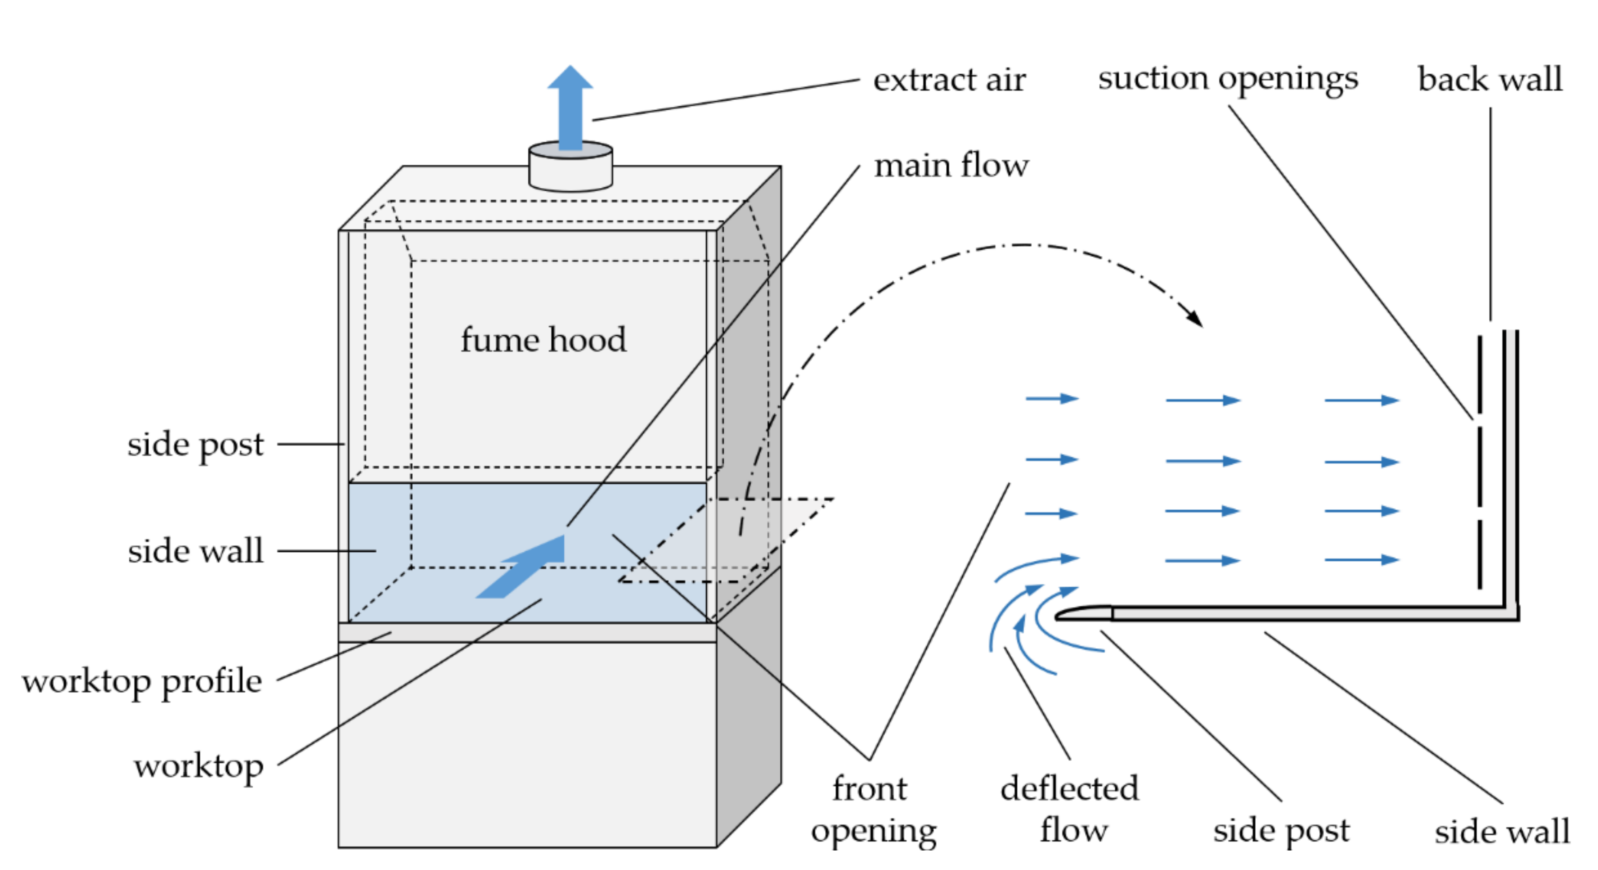
FUME HOODS
Never work with sash above warning line (18”)
Fume hood organization should allow for air flow at ~100 LFM at max sash height
Chemicals should be stored within the airfoil
When not in use, close the sash
Will be ordering supplies soon to improve fume hood organization
Increasing signage around fume hood

Slide 12
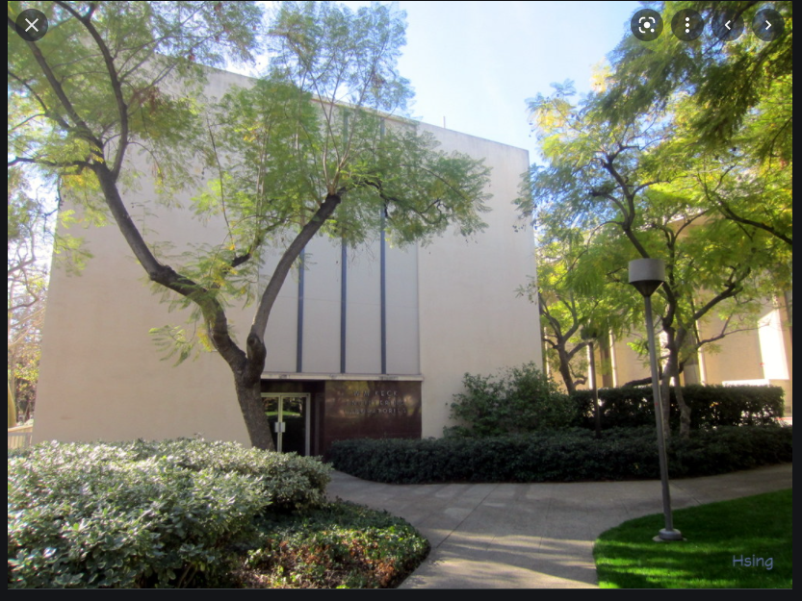
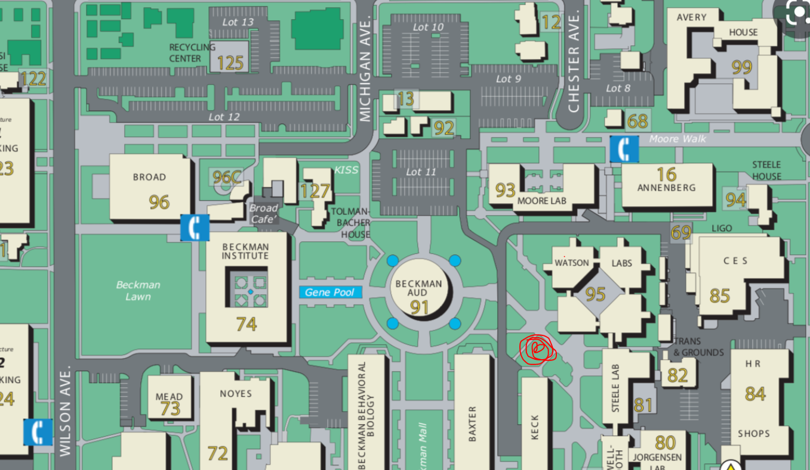
Emergency assembly point
This exact lawn (grass area) is the emergency assembly when there's a fire alarm and requiring evacuation
Note: You need to shelter in place for certain emergencies (I.e. Active shooter). Please refer to Emergency Response Guide near all exit doors in lab.

